Slide 1
Recognition of Unistroke Gesture Sequences
Presented by
Justin Permar
&
Arvind Krishnaa Jagannathan

Slide 2
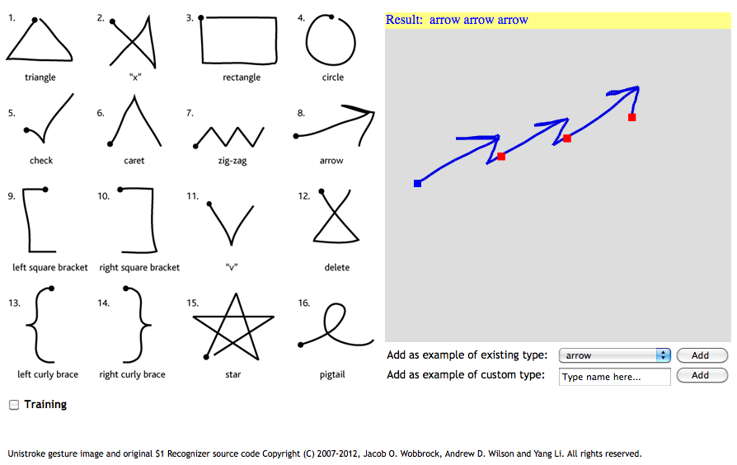
Problem Statement
To develop a gesture recognition system, which will segment the input sequence consisting of multiple gestures, drawn in one stroke, into the constituent gestures and then identify each individual gesture from a predefined set.
Our primary objective in solving this problem is to have as little training data as possible and to build a quick prototypical system which will be up and running quickly without consuming user’s time.

Slide 3
Related Work
Recognition of individual gestures in unistroke and multistroke sequences of digits – Yang et al: Training HMMs for continuous sequences
Individual gesture recognition : Extracting several features from an input and constructing Hidden Markov Models for each gesture – Tanguay
Recognizing an individual unistroke gesture sequence, using a distance measure from existing templates - $1 Recognizer - Wobbrock et al

Slide 4
Our Approach – Salient Features
Extend $1 recognizer to identify multiple gestures in a gesture sequence.
Hardest problem is that of segmentation – Classified in literature as “Inverse Perception Problem”.
Based on a “Visual Affinity” approach – a type of geometric match.
Employs Dynamic Time Warping to decide the minimum distance measure from a given template.
No restriction on gestures in the input sequence –
Arbitrarily long
Can contain any pre-defined gesture. New gestures can also be added to the system.

Slide 5
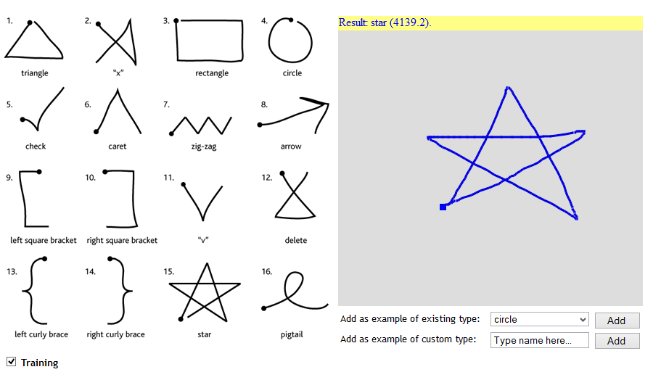
Approach – Training mode
User draws one of the pre-defined gestures, or adds a new gesture, with the system in training mode.
Only individual gestures are drawn – no need to train the system with gesture sequences.
If misclassification occurs during training, user can indicate what the correct gesture was meant to be.
Score next to the shape indicates the distance measure from closest resembling gesture template available.

Slide 6
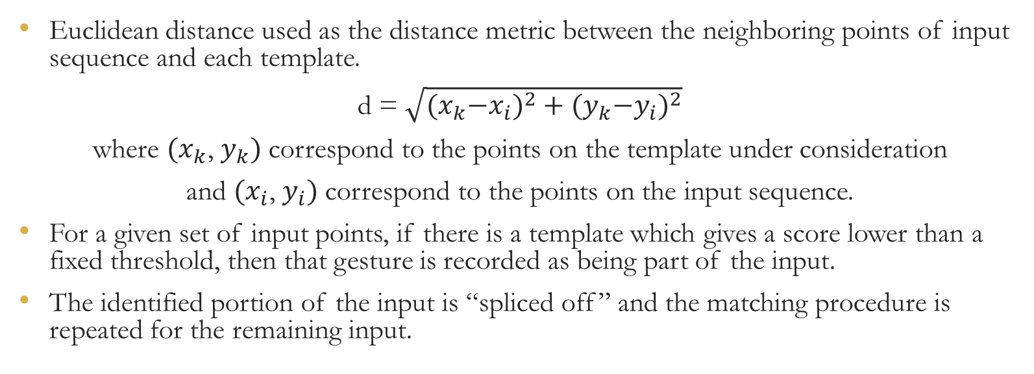
Approach – Match using Dynamic Time Warping
Euclidean distance used as the distance metric between the neighboring points of input sequence and each template.
d = $\sqrt{{{(x}_{k}−x_{i})}^{2}+{{(y}_{k}−y_{i})}^{2}}$
where ${(x}_{k}$, $y_{k})$ correspond to the points on the template under consideration
and ${(x}_{i}$, $y_{i})$ correspond to the points on the input sequence.
For a given set of input points, if there is a template which gives a score lower than a fixed threshold, then that gesture is recorded as being part of the input.
The identified portion of the input is “spliced off” and the matching procedure is repeated for the remaining input.

Slide 7
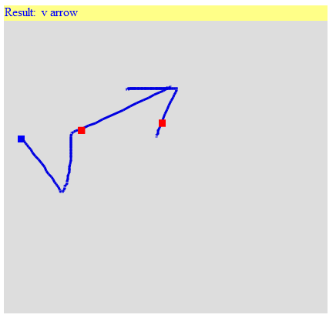





Approach – Segmentation and Recognition
First 64 equidistant points
No Match
Slide the input set of points
Match with “v” (First dot)
Remaining input
Input Gesture Sequence
Blue Dot – Start of the Sequence
Red Dots – Points at which sequence is segmented
First 64 equidistant points from remaining input – No Match
Sliding the set of points
Match with “Arrow” (Final dot)

Slide 8
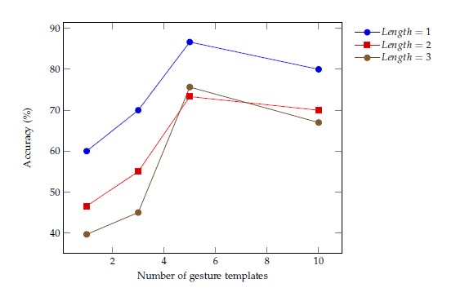

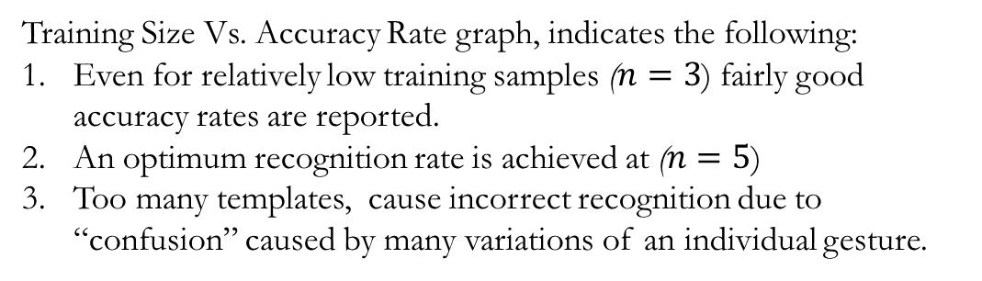
Results and Interpretation
Sequence Length | Accuracy Rate (%)
1 | 57.5
2 | 32.16
3 | 25.72
Sequence Length | Segmentation Accuracy(%)
1 | 71.5
2 | 71.5
3 | 52.27
Sequence Length | Relaxed Accuracy (%)
2 | 56.19
3 | 56.37
Table:3 Relaxed Accuracy
Table:1 Overall Accuracy – Exact Match
Table:2 Segmentation Accuracy
$$Relaxed Accuracy=\frac{Reported Gestures in input}{Total Gestures in input sequence}$$
Training Size Vs. Accuracy Rate graph, indicates the following:
Even for relatively low training samples ($n=3$) fairly good accuracy rates are reported.
An optimum recognition rate is achieved at ($n=5$)
Too many templates, cause incorrect recognition due to “confusion” caused by many variations of an individual gesture.

Slide 9
Discussion
Training only on individual gestures – lose features indicating a transition from one gesture to another (such as a pause)
Alternatively, explore the idea of Hidden Markov Models.
Construct HMMs for each individual gesture in the “gesture library” and then chain HMMs to construct arbitrarily long sequences of gestures.
Throw input sequence to each of these HMMs – the one resulting in the highest Viterbi probability is the desired set of individual gestures.
Compromise training time and computation for improved accuracy.

